Slide 1








Slide 2

Hotels Price Analysis - Using OYO
Submitted By-:
Pradipta Kumar Dixit

Slide 3

Contents:
Objective
Scraping details
Libraries Used
Data Cleaning and Data Manipulation
EDA(Univariate ,Bivariate & Multi-variate)
Challenges Faced
Scenarios
Conclusion

Slide 4
Objective:
OYO is a hotel management and booking company that aims to provide affordable and standardized accommodation options to travelers. One way to analyze the prices of hotels on OYO would be to compare the prices of similar hotels in the same location . we could also compare the prices of hotels on OYO with the prices of hotels on other booking platforms or the prices listed on the hotel's own website.
Problem Statement:
Price analysis based on features like wifi, elevator,tv etc..
Price analysis based on votes and ratings
Based on the location
Display the most popular hotels over the city
Correlation

Slide 5
Web Scraping:
Web scraping, also known as web data extraction, is the process of collecting data from websites. It involves making HTTP requests to a website's server, downloading the HTML content of the webpage, and then parsing that content to extract the data you need.
Web scraping can be done manually, using a web browser and a set of instructions to extract the data. However, it is more commonly done using specialized software or scripts that automate the process. Web scraping can be used for a variety of purposes, such as data mining, data analysis, and content aggregation.
Steps:
URL that you want to scrape.
Inspecting the Page.
Find the data you want to extract.
Run the code and extract the data.
Store the data in the required format.

Slide 6
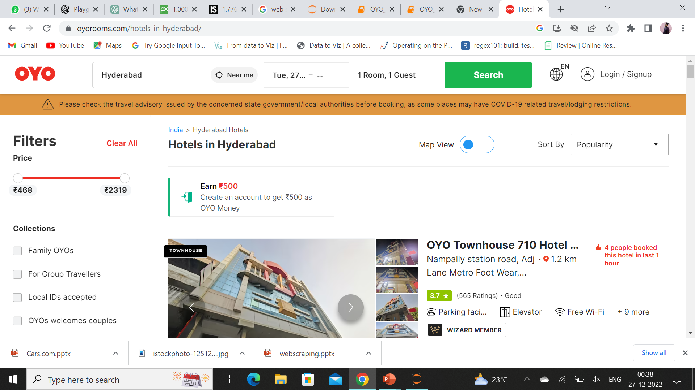
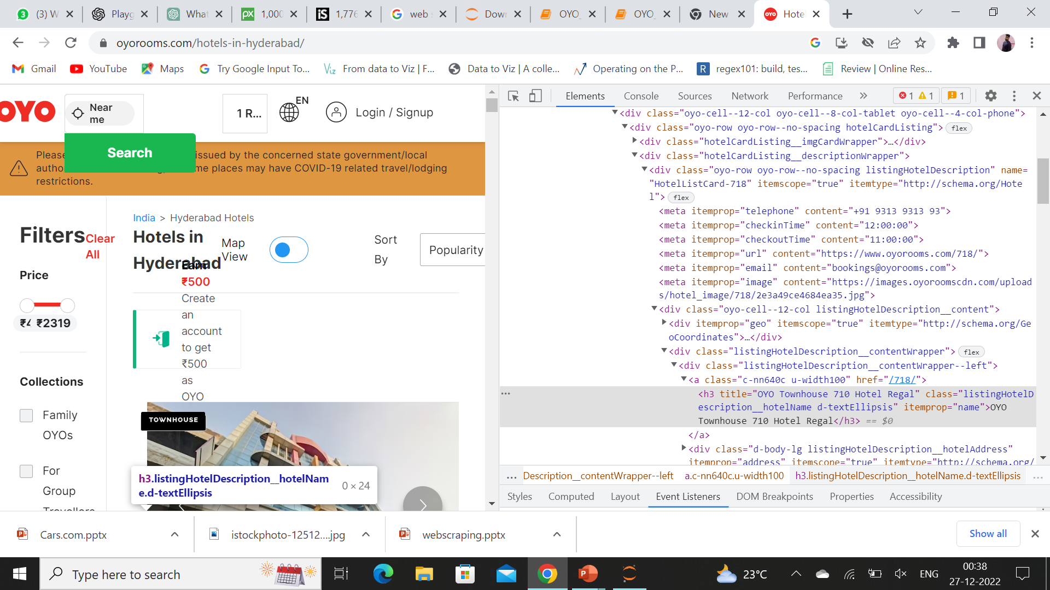
Website:
https://www.oyorooms.com/hotels-in-hyderabad/
https://www.oyorooms.com/hotels-in-bangalore/
https://www.oyorooms.com/hotels-in-delhi/
https://www.oyorooms.com/hotels-in-kolkata/

Slide 7



Libraries used:
requests
BeautifulSoup
pandas
Numpy
seaborn
RegEx
matplotlib
plotly

Slide 8
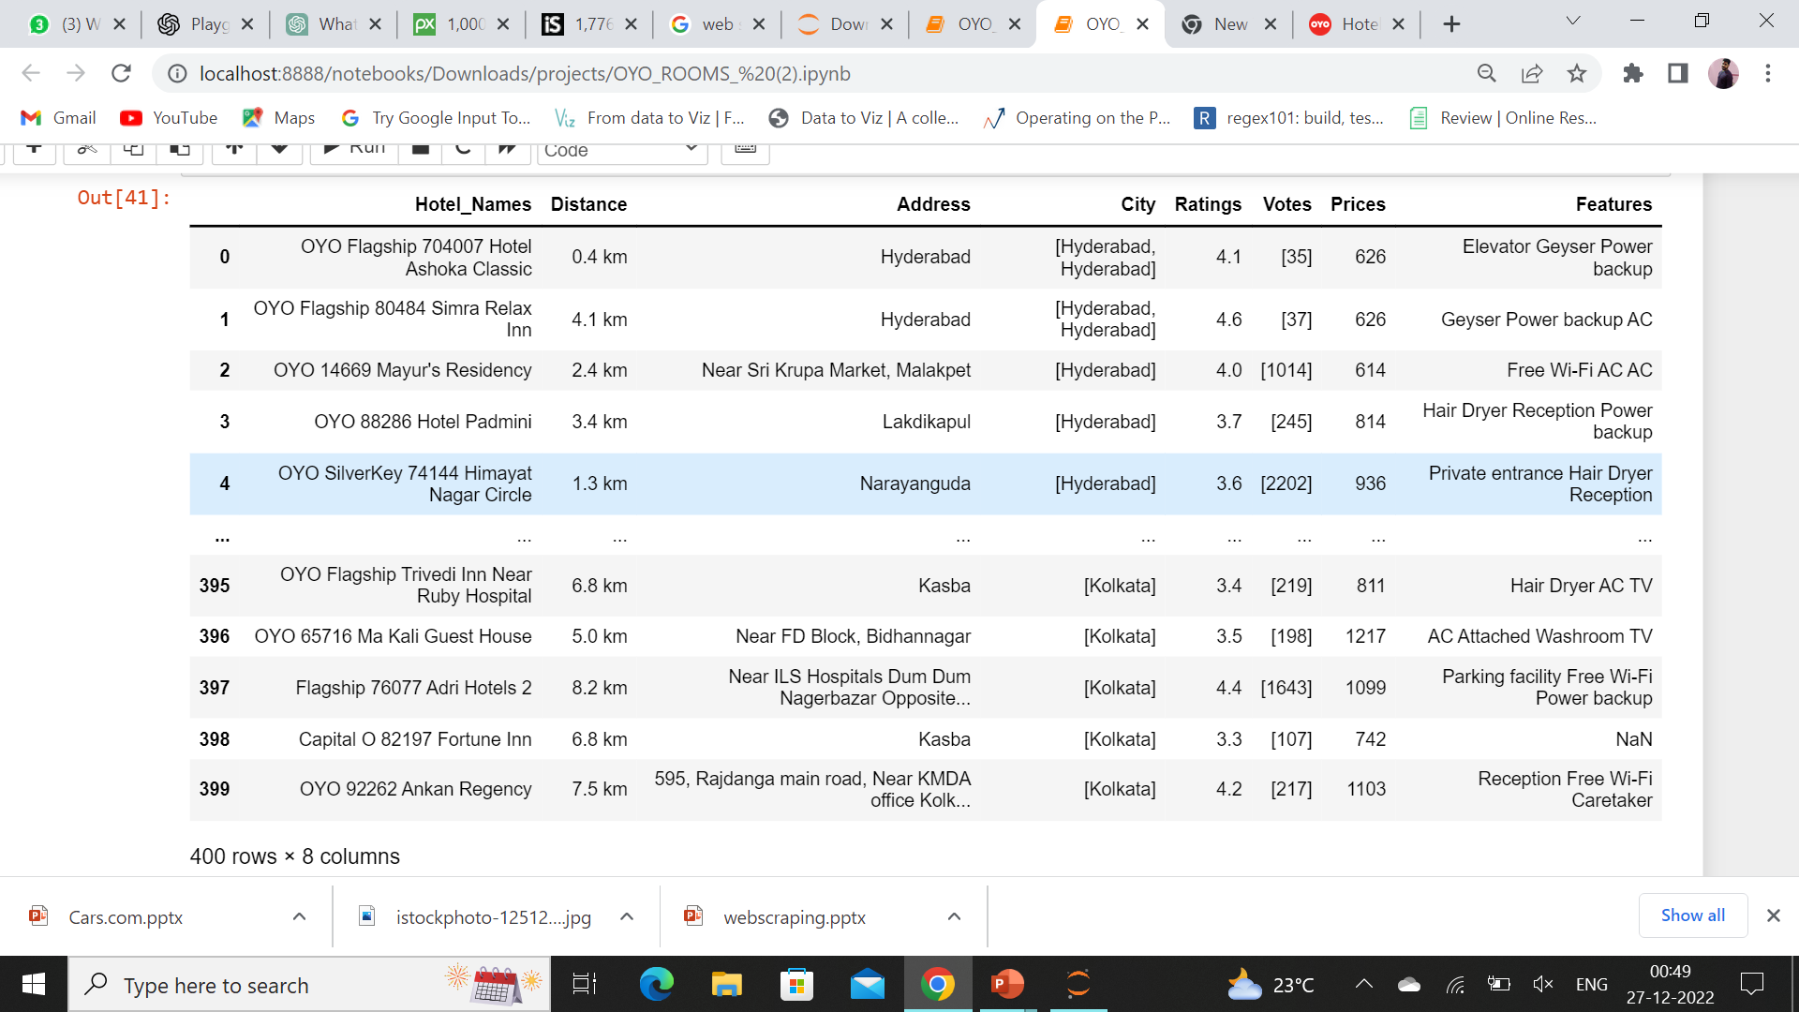
RAW Data Collection from Oyo Site

Slide 9
Data Cleaning Steps:
Check for Duplicates
Drop the duplicate column and unnecessary columns.
Checking and removing special characters.
Identifying and imputing missing values.
Data Type conversion.

Slide 10
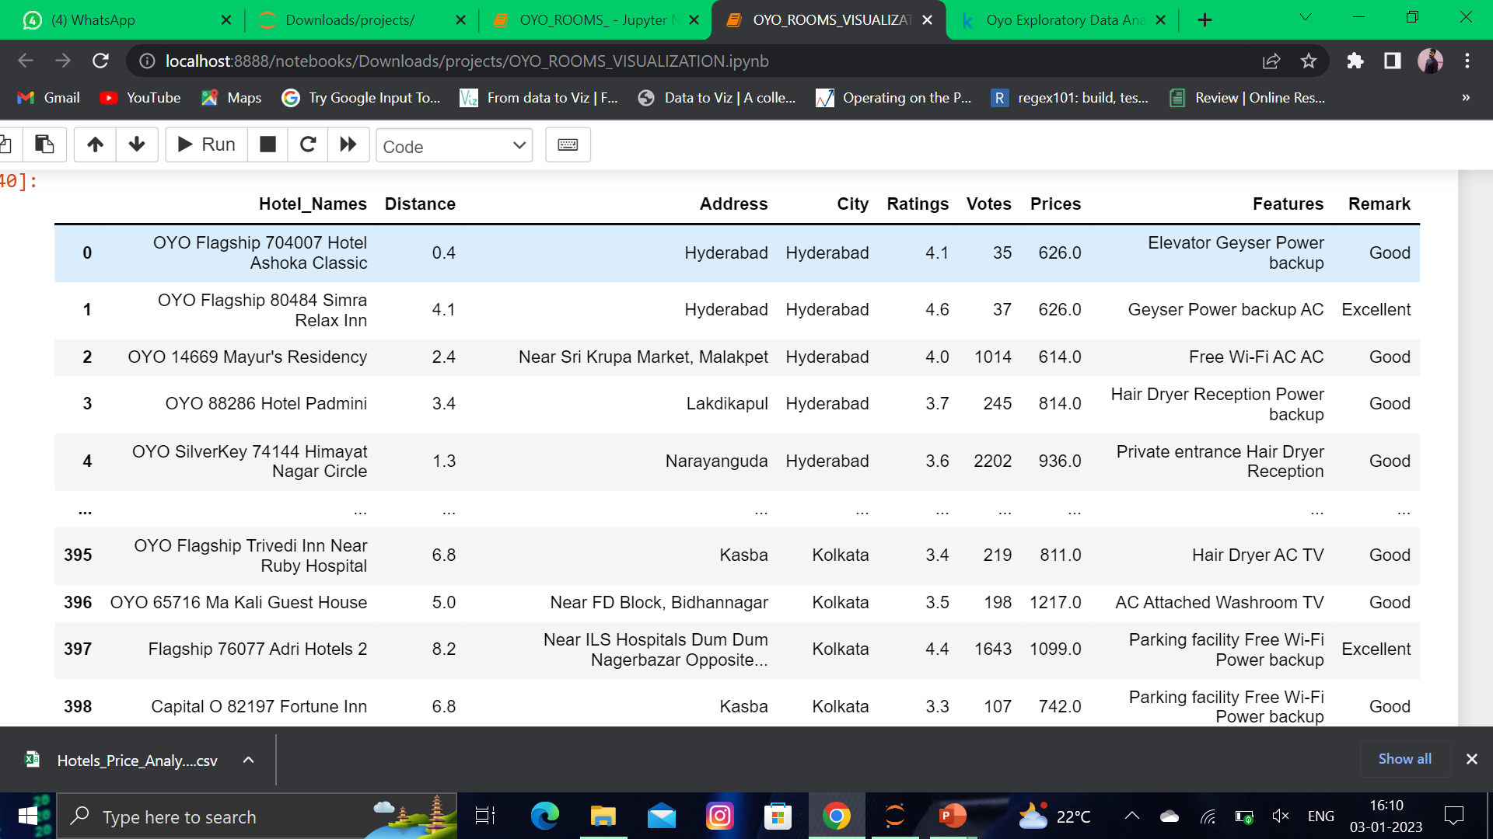
Data Collection from Oyo Site
RAW Data
Cleaned Data

Slide 11
Data Visualization
Data visualization is the process of creating and communicating data and information through the use of visual elements such as charts, graphs, and maps. It is a way to represent data and information in a graphical or pictorial format, which makes it easier to understand and analyze. Data visualization helps to identify patterns, trends, and correlations in data, and can be used to communicate complex ideas in a clear and concise way.
Uni variate:
Categorical
Numerical
Univariate analysis is the simplest form of analyzing data. “Uni” means “one”, so in other words your data has only one variable.
In univariate use can use bar, pie, count graph for categorical and dis, violin, hist plot For numerical column.
Bi variate:
Categorical vs categorical
Num vs Num
Num vs categorical
Bivariate analysis means the analysis of bivariate data. This is a single statistical analysis that is used to find out the relationship that exists between two value sets. The variables that are involved are X and Y.
Bivariate data analysis is when exactly two variables are analyzed.
In Bivariate use can use count and scatter plot for categorical vs categorical and bar , strip, scatterplot For categorical vs numerical column and scatter plot for numerical vs numerical column.
Multi variate:
Multivariate analysis is a statistical technique that involves the analysis of data sets that have more than one variable. It is used to examine the relationships between multiple variables and can help to identify patterns and trends in the data.

Slide 12
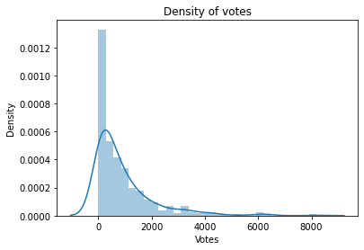
Univariate- Numerical
Distribution of votes:
From the above graph we can conclude the density is more in the range 0-2000 votes ,so most of the hotel votes are in that range.

Slide 13
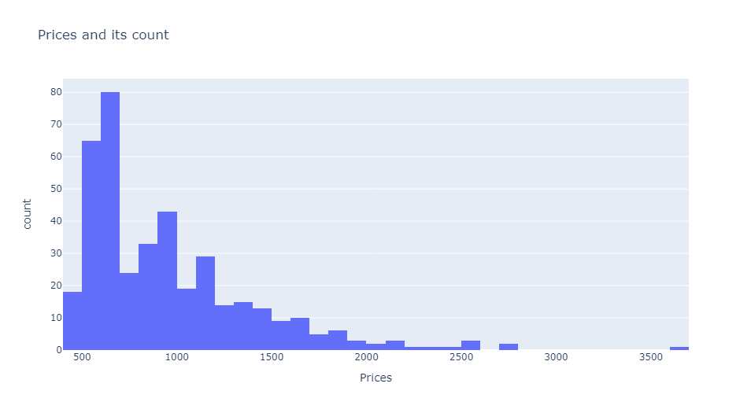
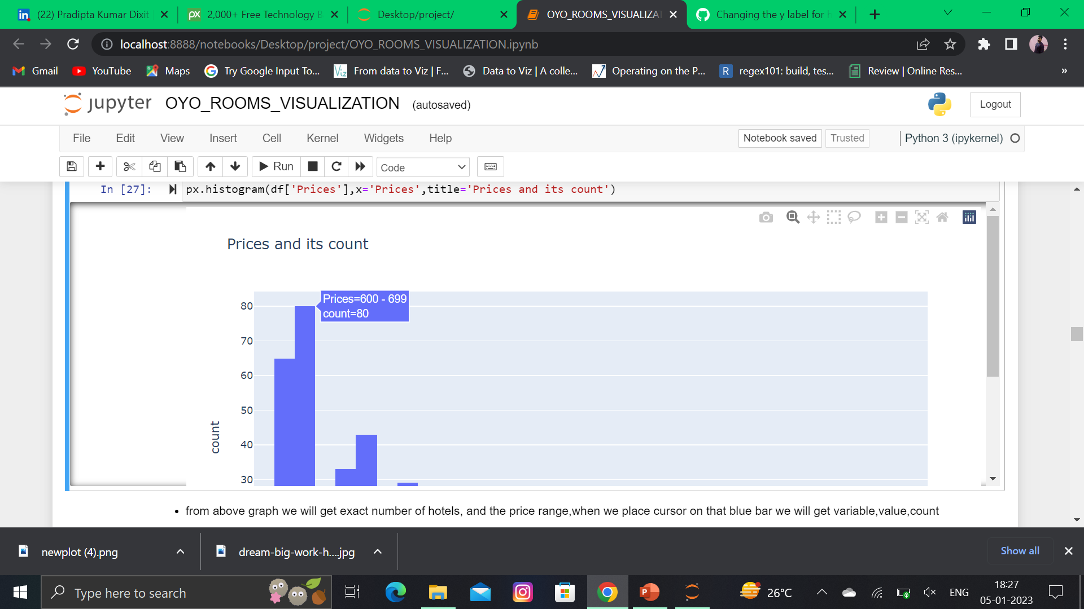
Distribution of Prices:
From above graph we will get exact number of hotels, and the price range,when we place cursor on that blue bar we will get variable,value,count.

Slide 14
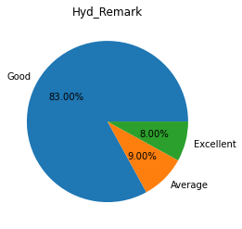
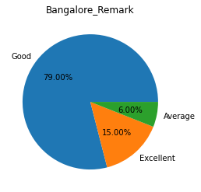
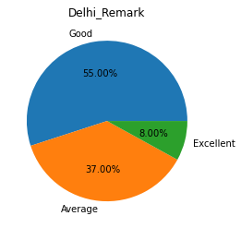
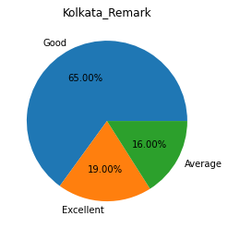
Univariate- Categorical
Hotels Based on Remarks-:
From above graph we are getting the exact percentage of hotels which belongs to the remark categorical in all city.

Slide 15
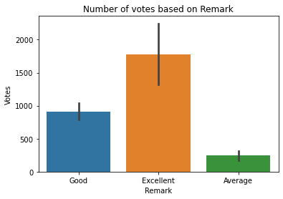
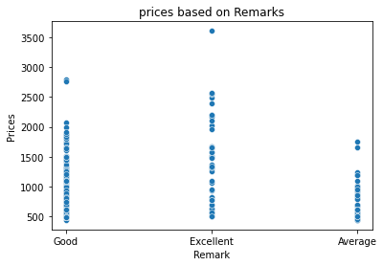
Bivariate- Categorical vs Numerical
Votes and Prices Distribution Based on Remark-:
From the above graph we can conclude that most of the hotels which are in excellent category have more votes.
From the above graph we can conclude that most of the hotels which are in excellent category have more prices.

Slide 16
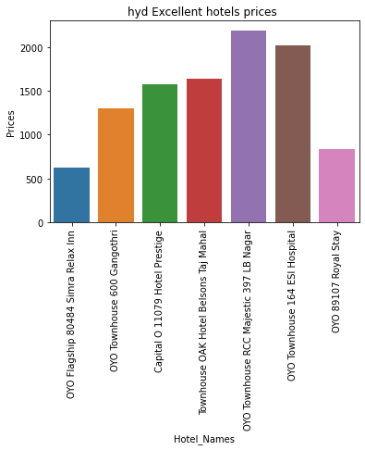
Excellent Hotels in Hyderabad and it’s Prices
From the above graph we can conclude these are the best hotels in hyderabad city and from the above we observed that these particular RCC Majestic 397 LB Nagar hotel has max price

Slide 17
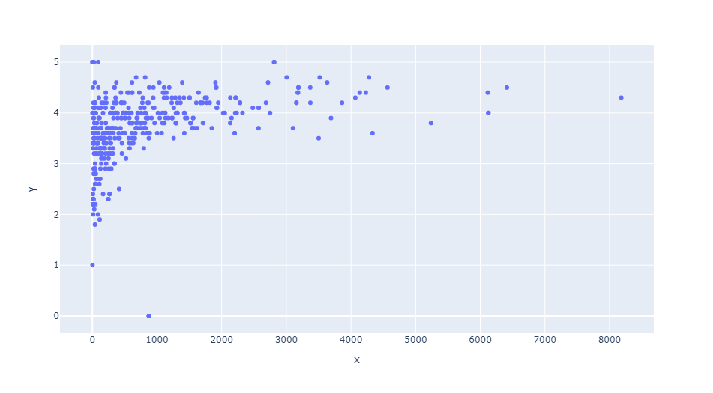
Bivariate- Numerical vs Numerical
Ratings Based on Votes :
From above graph we can conclude if the votes are increasing then rating also will increase.

Slide 18
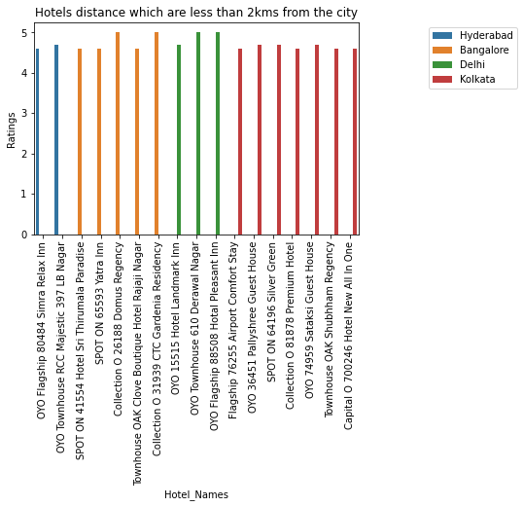
multivariate
Hotels name which distance is less than 2km from the city
From the above graph we can observe that Bangalore city hotels has max number of ratings when compare to other city and these all hotels has a distance less than 2 kms from the corresponding city.

Slide 19
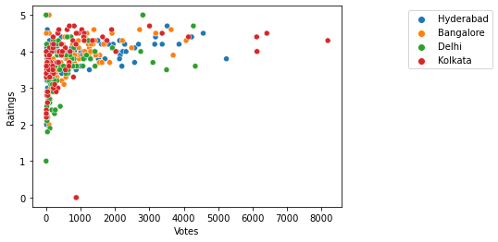
Votes and ratings of Different Cities:
From the above graph we can conclude that most of the hotels lie with in the range of 0-3000 votes and kolkata has the max rating.

Slide 20
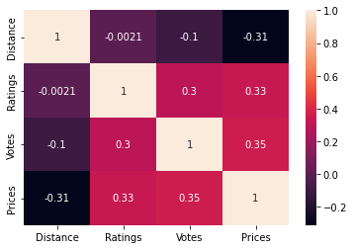
Correlation
From the above plot we can conclude that there are positive relations and negative relationship the positive relation and the positive relation depicts the relation between the two different columns where as negative relation does not effect any columns .

Slide 21
Challenges faced:
Our project is based on Oyo website ,we need to scrap data from Oyo website .Once we created DataFrame after
collecting data .If we restart the jupyter Notebook then length of the data will be vary for all columns for creating the
Data Frame .Because Oyo room can be booked at any time and again it will be normal at morning.
While cleaning a column named city. We have some empty space we need to replace that empty space with that particular city, but that space is not one space ,it is more than some spaces.
* We faced some problems in visualization , like deciding which plot suits for which columns.

Slide 22
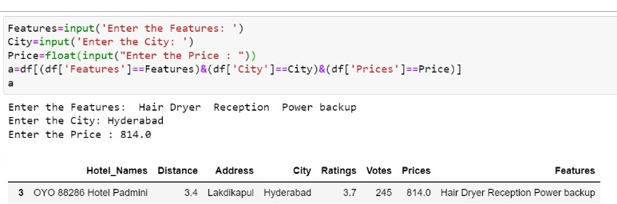
Scenario 1-:
With the help of these code we can know the Hotel_Names by giving particular City,Price and features.
User must have to insert the features ,price,city in pascal casing.(pascal casing says that every words first letter must be in capital letter)

Slide 23
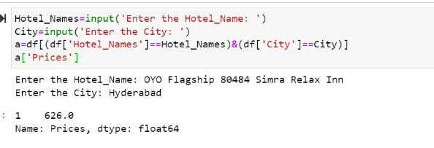
Scenario 2-:
With the help of these code we can know the price of any hotel by giving the city and Hotel_Names.
User must have to insert the features ,price,city in pascal casing.(pascal casing says that every words first letter must be in capital letter)

Slide 24
Conclusion
An analysis of hotel prices can be a useful tool for determining the average cost of accommodations in a specific location or for comparing the prices of different hotels or hotel chains. There are a variety of factors that can affect the price of a hotel room, including the location, demand and services offered.

Slide 25

THANK YOU

